Slide 1
Topological Sort Algorithm

Slide 2
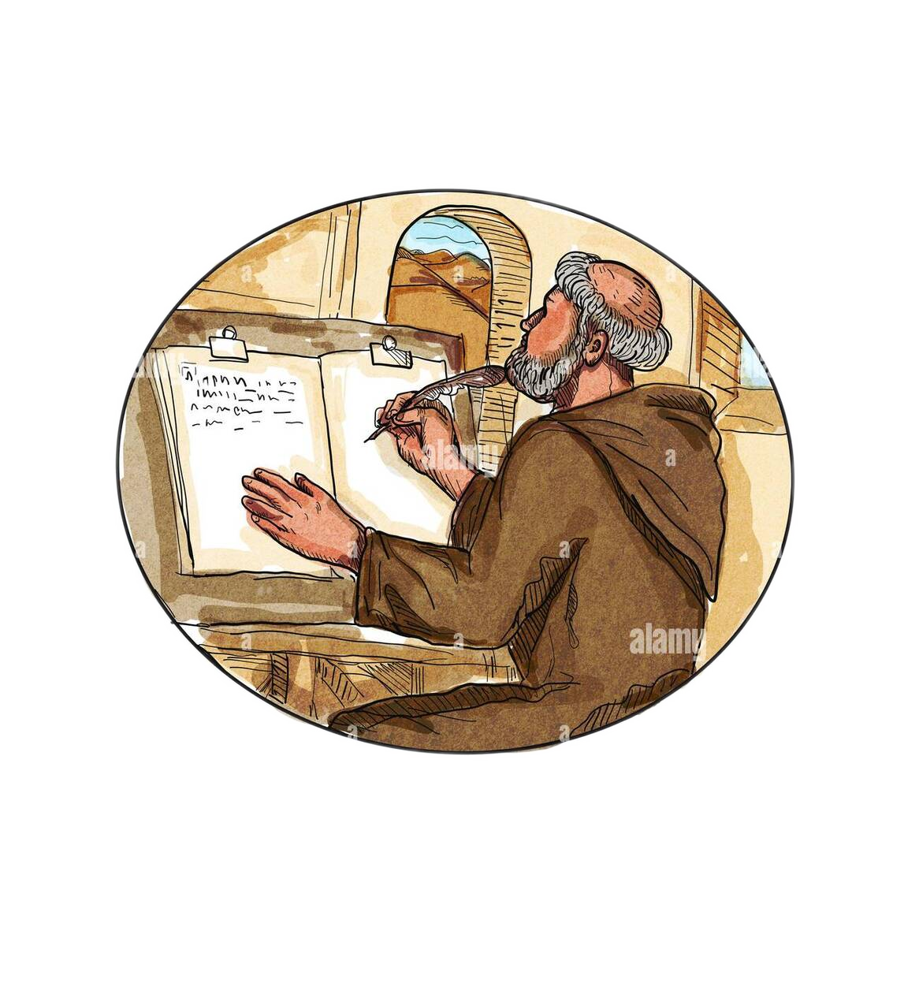
Presented by…
SK. Azraf Sami
Department of Computer Science and Engineering
Roll : 1907115
Wasif Zahin
Department of Computer Science and Engineering
Roll : 1907112

Slide 3
Once upon a time, there was a kingdom…
Here king has only one daughter…
But his daughter was always unhappy…
Princess had many jewelers items, she wanted to ordering all items…
So, to see a happy face of his daughter, king give an announcement…

Slide 4

“Any guy who find a easy solution, I will like to marry my daughter to this person…”

Slide 5

A prince whose name “Topo” lived in “Algo” island…
I think I got an Idea…

Slide 6
Yeah, I can connect all stuff like this and all connections have particular direction…
I call it graph..
A
B
D
C

Slide 7
Oh, before starting I need to clear another concept in-degree and out-degree…
1 / 2
A
1 / 0
B
D
0 / 1
C
2 / 0

Slide 8
Here, my idea…
Which vertex has in-degree zero?
Delete all the edges outgoing from this vertex.
Repeat above two steps until all vertices are taken.

Slide 9
Now, see it…
1
A
1
B
D
0
C
2

Slide 10
Now, see it…
1
0
A
1
B
C
2
1
D

Slide 11
Then…
0
B
C
0
D A

Slide 12
But, now, I have two vertices with 0 in-degree. Which vertex I will consider?
Yeah, I also get another combination with another vertex…

Slide 13
Now, I consider Vertice “B” first…
And here, I consider Vertice “C” first…
0
0
B
B
C
C
0
0
D A
B
D A
C

Slide 14
Now, I consider Vertex “C”…
And here, I consider Vertex “B”…
0
B
C
0
D A C
B
D A B
C

Slide 15
So, one graph can have multiple sort in this process?
Yes, it is possible…

Slide 16
Does this algorithm work for all type of graphs?
Um…Not actually. It only works for directed acyclic graph.

Slide 17
Why?!

Slide 18
Well, please, see this example…
2
1
A
0
B
D
1
C
1
B

Slide 19
Now, see there are no node with zero in–degree…
1
A
D
1
C
1
B

Slide 20
Oh! this boy is honest! He describes limitation of this process!
Bravo! I think we get our champion!

Slide 21
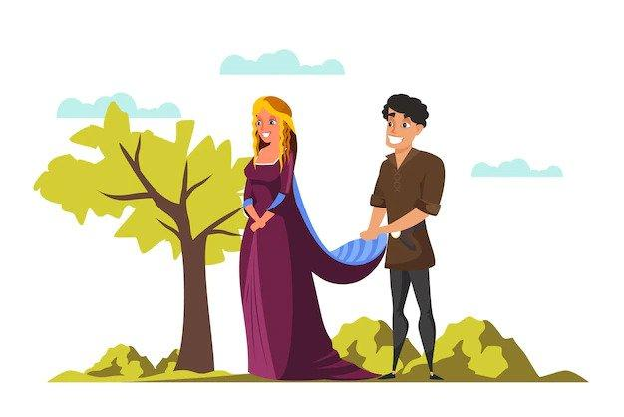
Marriage life of prince and princess…
Moral of the story…
Definition of Topological Sort…
Given a digraph G = (V, E), a total ordering of G's vertices such that for every edge (v, w) in E, vertex v precedes w in the ordering.

Slide 22
Algorithm:
map := {each vertex its in-degree}.
queue := {all vertices with in-degree = 0}.
ordering := { }.
Repeat until queue is empty:
Dequeue the first vertex v from the queue.
ordering += v.
Decrease the in-degree of all v's neighbors by 1 in the map.
queue += {any neighbors whose in-degree is now 0}.
If all vertices are processed, success.
Otherwise, there is a cycle.

Slide 23
Algorithm:
map := {each vertex its in-degree}. // O(V)
queue := {all vertices with in-degree = 0}.
ordering := { }.
Repeat until queue is empty: // O(V)
Dequeue the first vertex v from the queue. // O(1)
ordering += v. // O(1)
Decrease the in-degree of all v's // O(E) for all passes
neighbors by 1 in the map.
queue += {any neighbors whose in-degree is now 0}.
Overall: O(V + E) ; essentially O(V) time on a sparse graph (fast!)

Slide 24
Now-a-days, this process is known as “Topological Sorting Algorithm” by the name of the Price “Topo”
Finding cycle in a graph
Operation System deadlock detection
Sentence Ordering
Critical Path Analysis
Logic Synthesis
Data Serialization

Slide 25
Special Thanks To:
Md. Ahsan Habib
Lecturer
Department of Computer Science and Engineering
Khulna University of Engineering & Technology (KUET)
Khulna -9203, Bangladesh.
END…

